Slide 1
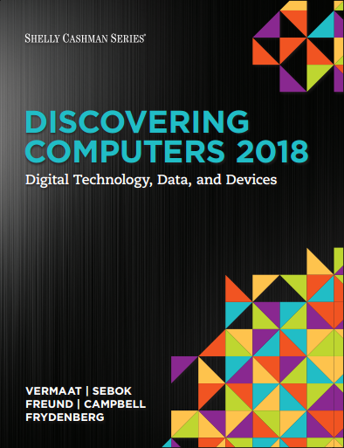

DISCOVERING COMPUTERS 2018 Digital Technology, Data, and Devices
Module 7
Input and Output: Extending Capabilities of Computers and Mobile Devices
Copyright © 2018 Cengage Learning®. May not be scanned, copied or duplicated, or posted to a publicly accessible website, in whole or in part.

Slide 2
Objectives Overview (1 of 2)
Differentiate among various types of keyboards: standard, compact, on-screen, virtual, ergonomic, gaming, and wireless
Describe characteristics of various pointing devices: mouse, touchpad, and trackball
Describe various uses of touch screens
Describe various types of pen input: stylus, digital pen, and graphics tablet
Describe various uses of motion input, voice input, and video input

Slide 3
Objectives Overview (2 of 2)
Differentiate among various scanners and reading devices
Explain the characteristics of various displays
Summarize the various types of printers
Identify the purpose and features of speakers, headphones and earbuds, data projectors, interactive whiteboards, and force-feedback game controllers and tactile output
Identify various assistive technology input and output methods

Slide 4
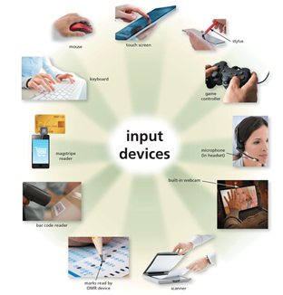
What Is Input? (1 of 2)
Input is any data and instructions entered into the memory of a computer
Figure 7-1 Users can enter data and instructions into computers and mobile devices in a variety of ways.

Slide 5
What Is Input? (2 of 2)
Commonly used input methods include:
Keyboard
Pointing devices
Touch screens
Pen input
Motion input
Voice input
Video input
Scanners and reading devices

Slide 6
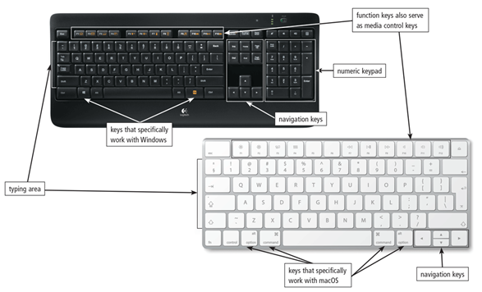
Keyboards (1 of 4)
A keyboard is an input device that contains keys you press to enter data and instructions into a computer or mobile device
Figure 7-2 On a standard keyboard, you type using keys in the typing area and on the numeric keypad. Some of the keys on standard keyboards differ, depending on the operating system with which they are designed to work.

Slide 7
Keyboards (2 of 4)
Nearly all keyboards have…
Typing area
Function keys
Toggle key
Navigation keys
Media control buttons
Internet control buttons
Other special keys

Slide 8
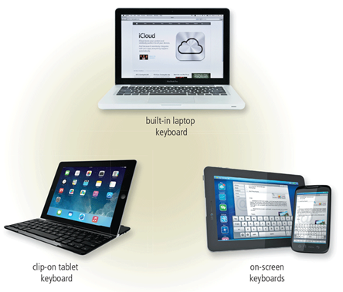
Keyboards (3 of 4)
There are a variety of keyboard options for mobile computers and devices
Figure 7-3 User have a variety of keyboard options for mobile computers and devices.

Slide 9
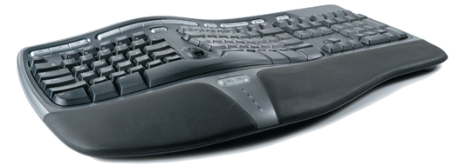
Keyboards (4 of 4)
An ergonomic keyboard has a design that reduces the chance of repetitive strain injuries (RSIs) of wrist and hand
Ergonomics incorporates comfort, efficiency, and safety in the design of the workplace
Figure 7-4 An ergonomic keyboard.

Slide 10
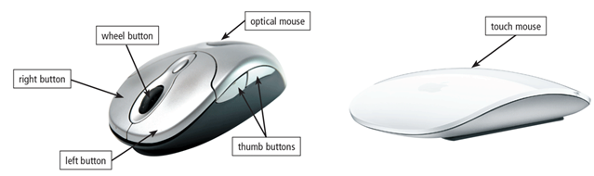
Pointing Devices (1 of 3)
A pointer is a small symbol on the screen whose location and shape change as a user moves a pointing device
A mouse is a pointing device that fits under the palm of your hand comfortably
Optical mouse, laser mouse, and touch mouse
Figure 7-5 An optical mouse has buttons. A touch mouse often has no buttons

Slide 11
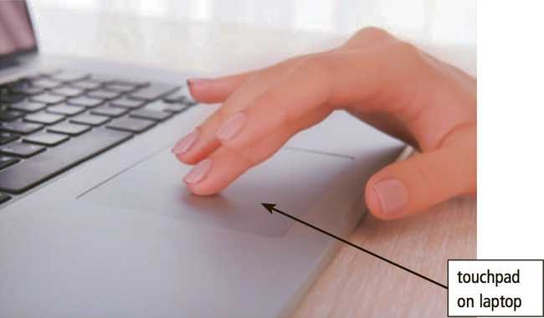
Pointing Devices (2 of 3)
Touchpad
A touchpad is a small, flat, rectangular pointing device that is sensitive to pressure and motion

Slide 12
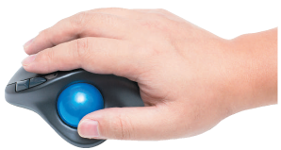
Pointing Devices (3 of 3)
Trackball
A trackball is a stationary pointing device with a ball on its top or side

Slide 13
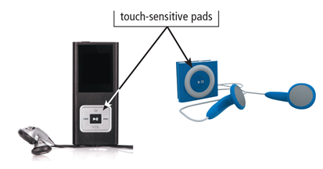
Touch Screens
A touch screen is a touch-sensitive display
Figure 7-8 You use your thumb or finger to rotate or press buttons on a touch-sensitive pad, which commonly is found on portable media players.

Slide 14
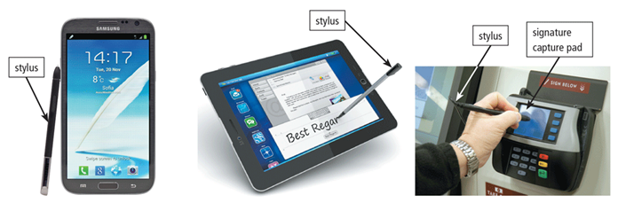
Pen Input (1 of 2)
With pen input, you touch a stylus or digital pen on a flat surface to write, draw, or make selections
Figure 7-9 You use a stylus to write, draw, or make selections on a touch screen that supports pen input.

Slide 15
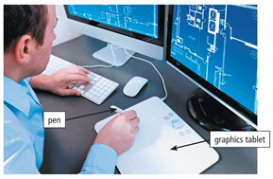
Pen Input (2 of 2)
A graphics tablet, also called a digitizer, is an electronic plastic board that detects and converts movements of a style or digital pen into signals that are sent to the computer
Figure 7-11 Architects use a graphics tablet to create blueprints.

Slide 16
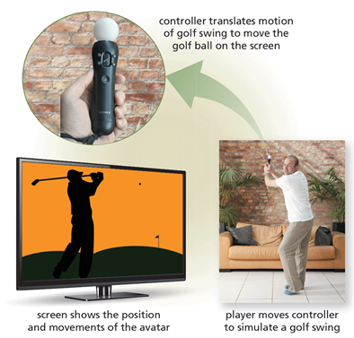
Motion, Voice, and Video Input (1 of 8)
With motion input, sometimes called gesture recognition, users can guide on-screen elements using air gestures

Slide 17
Motion, Voice, and Video Input (2 of 8)
Voice input is the process of entering input by speaking into a microphone
Voice recognition, also called speech recognition, is the computer or mobile device’s capability of distinguishing spoken words

Slide 18
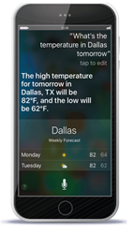
Motion, Voice, and Video Input (3 of 8)
Figure 7-12 With Siri / Google Assistant / Cortana, you can speak instructions and commands to the smartphone and its apps. As shown here, the user asks Siri about the weather, to which Siri replies by speaking a message and displaying the forecast.

Slide 19
Motion, Voice, and Video Input (4 of 8)
Audio input is the process of entering any sound into the computer such as speech, music, and sound effects
Music production software allows users to record, compose, mix, and edit music and sounds

Slide 20
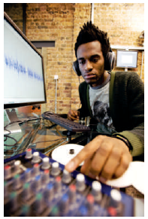
Motion, Voice, and Video Input (5 of 8)
Figure 7-13 This sound engineer uses a computer to mix music.

Slide 21
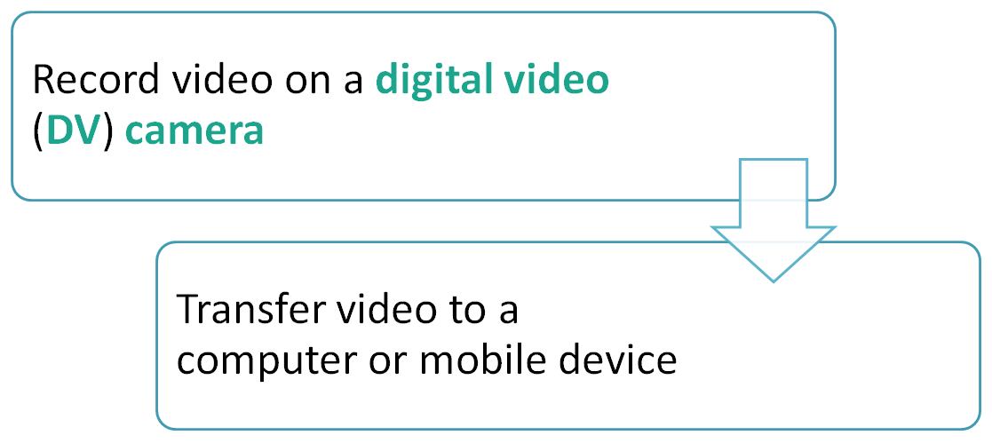
Motion, Voice, and Video Input (6 of 8)
Video input is the process of capturing full-motion images and storing them on a computer or mobile device’s storage medium

Slide 22
Motion, Voice, and Video Input (7 of 8)
A webcam is a type of DV camera that enables a user to:
Capture video and still images
Send email messages with video attachments
Broadcast live images or video over the Internet
Conduct videoconferences
Make video calls

Slide 23
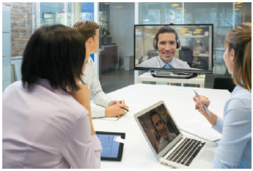
Motion, Voice, and Video Input (8 of 8)
A videoconference is a meeting between two or more geographically separated people
Figure 7-14 To save on travel expenses, many large businesses use videoconferencing.

Slide 24
Scanners and Reading Devices (1 of 10)
A scanner is a light-sensing input device that reads printed text and graphics and then translates the results into a form the computer can process
A flatbed scanner works in a manner similar to a copy machine except it creates a file of the document in memory instead of a paper copy

Slide 25
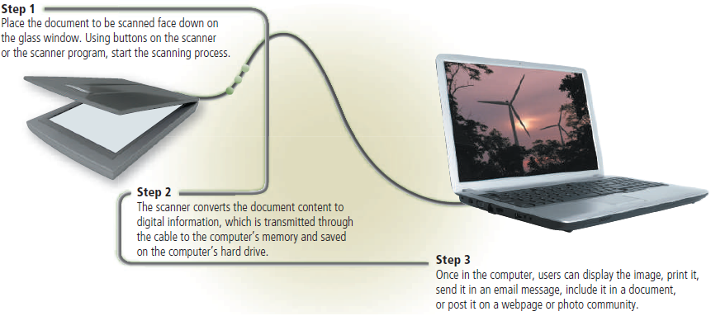
Scanners and Reading Devices (2 of 10)
Figure 7-16 This figure shows how a flatbed scanner works.

Slide 26
Scanners and Reading Devices (3 of 10)
An optical reader is a device that uses a light source to read characters, marks, and codes and then converts them into digital data that a computer can process
Optical character recognition (OCR)
Optical mark recognition (OMR)

Slide 27
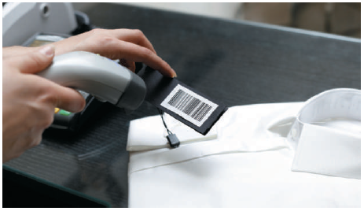
Scanners and Reading Devices (4 of 10)
A bar code reader, also called a bar code scanner uses laser beams to read bar codes
Figure 7-17 A bar code reader uses laser beams to read bar codes on products such as clothing, shown here.

Slide 28
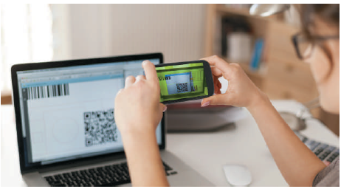
Scanners and Reading Devices (5 of 10)
A QR code stores information in both a vertical and horizontal direction
Figure 7-18 This customer pays her bills by scanning an on-screen QR code.

Slide 29
Scanners and Reading Devices (6 of 10)
RFID (radio frequency identification) uses radio signals to communicate with a tag placed in or attached to an object
An RFID reader reads information on the tag via radio waves
RFID can track:
Tracking times of runners in a marathon
Tracking location of people and other items
Checking lift tickets of skiers
Gauging temperature and pressure of tires on a vehicle

Slide 30
Scanners and Reading Devices (7 of 10)
Checking out library books
Managing purchases
Tracking payment as vehicles pass through booths on tollway systems
Magstripe readers read the magnetic stripe on the back of cards such as:
Credit cards
Entertainment cards
Bank cards
Identification cards
Other similar cards

Slide 31
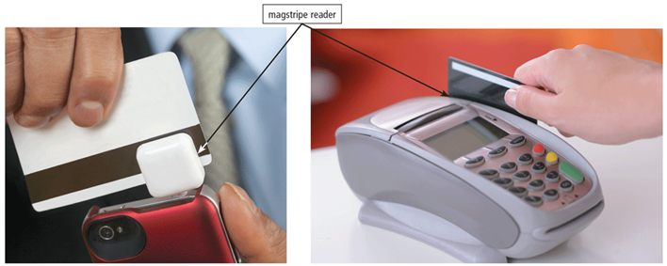
Scanners and Reading Devices (8 of 10)
Figure 7-20 A magstripe reader reads information encoded on the stripe on the back of a credit card.

Slide 32
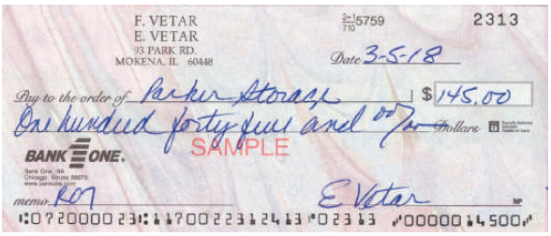
Scanners and Reading Devices (9 of 10)
MICR (magnetic ink character recognition) devices read text printed with magnetized ink
An MICR reader converts MICR characters into a form the computer can process
Banking industry uses MICR for check processing
Figure 7-21 The MICR characters preprinted on the check represent the bank routing number, customer account number, and check number. The amount of the check in the lower-right corner is added after the check is cashed.

Slide 33
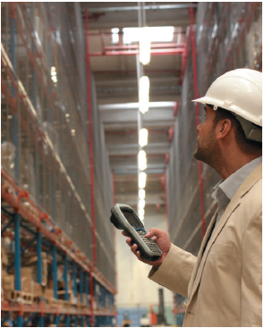
Scanners and Reading Devices (10 of 10)
A data collection device obtains data directly at the location where the transaction or event takes place
Figure 7-22 An employee in a warehouse uses this data collection device to scan items, which wirelessly transmits information about the scanned item to the store’s inventory system.

Slide 34
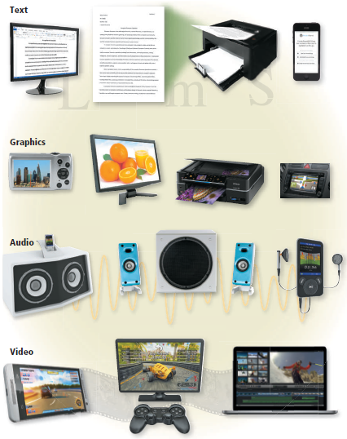
What Is Output?
Output is data that has been processed into a useful form
Figure 7-23 Four types of output are text, graphics, audio, and video.

Slide 35
Displays (1 of 5)
A display visually conveys text, graphics, and video information
A monitor is a display that is packaged as a separate peripheral device
LCD monitor
CRT (cathode-ray tube) monitor

Slide 36
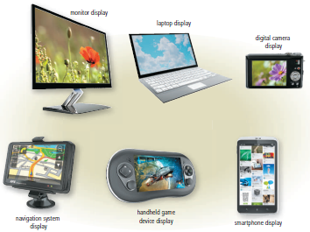
Displays (2 of 5)
Figure 7-24 A variety of displays.

Slide 37
Displays (3 of 5)
The quality of a display depends primarily on its:
Resolution
Response time
Brightness
Dot pitch
Contrast ratio
Today’s monitors use a digital signal to produce a picture

Slide 38
Displays (4 of 5)
To display the highest quality images, the monitor should plug in a:
A DVI port
An HDMI port
A Display Port
Home users sometimes use a digital television (DTV) as a display
HDTV is the most advanced form of digital television
A Smart TV is an Internet-enabled HDTV

Slide 39
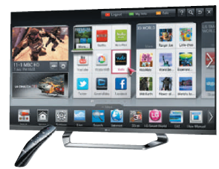
Displays (5 of 5)
Figure 7-25 Smart TVs enable you to connect to the Internet and/or watch television shows.

Slide 40
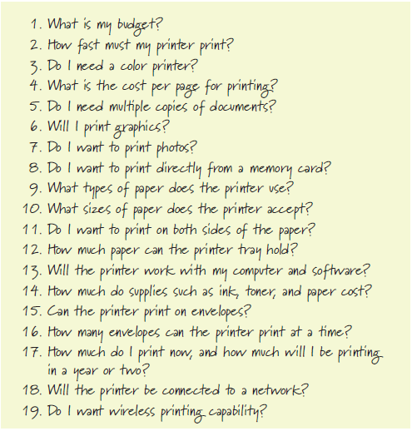
Printers (1 of 13)
A printer is an output device that produces text and graphics on a physical medium
Before purchasing a printer, ask yourself a series of questions
Figure 7-26 Questions to consider before purchasing a printer.

Slide 41
Printers (2 of 13)
A nonimpact printer forms characters and graphics on a piece of paper without actually contacting the paper
Ink-jet printers
Photo printers
Laser printers
All-in-one printers
3-D printers
Thermal printers
Mobile printers
Label printers
Plotters
Large-format printers

Slide 42
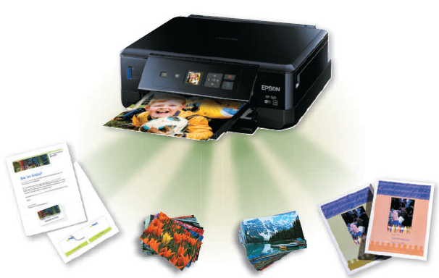
Printers (3 of 13)
An ink-jet printer forms characters and graphics by spraying tiny drops of liquid ink onto a piece of paper
Color or black-and-white
Speed is measured by the number of pages per minute (ppm) it can print
Figure 7-27 Ink-jet printers are a popular type of color printer used at home and in the office.

Slide 43
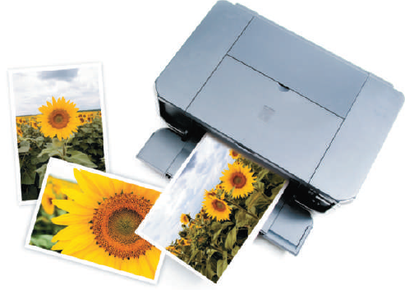
Printers (4 of 13)
A photo printer is a color printer that produces lab-quality photos
Many use ink-jet technology
Figure 7-29 A photo printer.

Slide 44
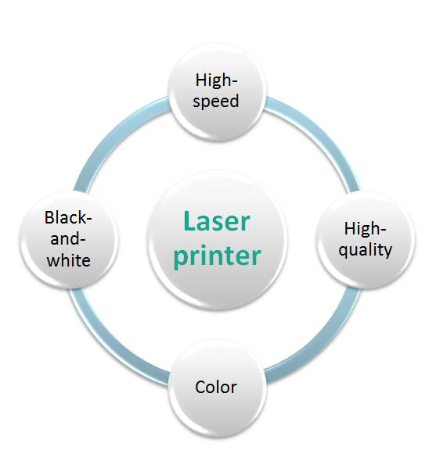
Printers (5 of 13)

Slide 45
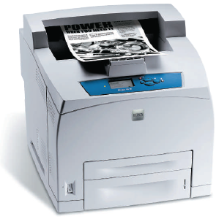
Printers (6 of 13)
Figure 7-30 A laser printer.

Slide 46
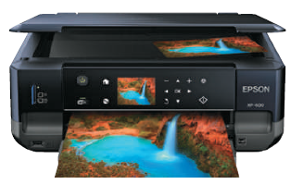
Printers (7 of 13)
An all-in-one printer is a single device that prints, scans, copies, and in some cases, faxes
Also called a multifunction printer
Figure 7-32 An all-in-one printer.

Slide 47
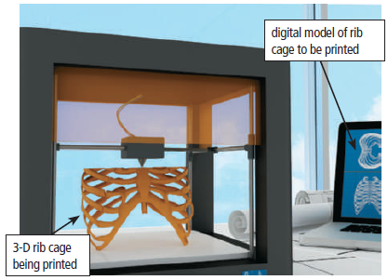
Printers (8 of 13)
A 3-D printer uses a process called additive manufacturing to create an object by adding material to a three-dimensional object, one horizontal layer at a time
Figure 7-33 A 3-D printer creates a rib cage from the digital model.

Slide 48
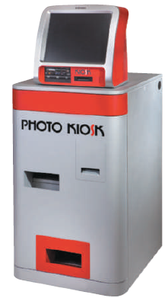
Printers (9 of 13)
A thermal printer generates images by pushing electrically heated pins against the heat-sensitive paper
Dye-sublimation printer
Figure 7-34 A dye-sublimation printer.

Slide 49
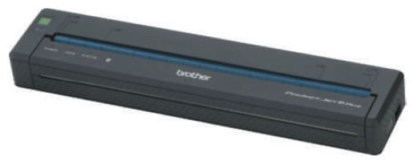
Printers (10 of 13)
A mobile printer is a small, lightweight, battery-powered printer that allows a mobile user to print from a mobile device
Figure 7-35 A mobile printer is small enough to fit in a backpack.

Slide 50
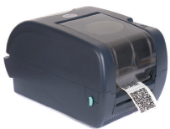
Printers (11 of 13)
A label printer is a small printer that prints on an adhesive-type material that can be placed on a variety of items
Figure 7-36 A label printer.

Slide 51
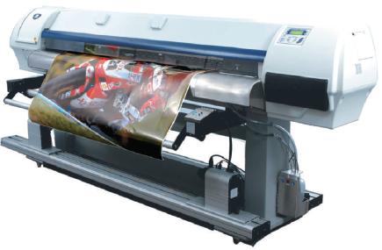
Printers (12 of 13)
Plotters are used to produce high-quality drawings
Large-format printers create photo-realistic quality color prints
Figure 7-37 Graphic artists use large-format printers to print signs, posters, and other professional quality displays.

Slide 52
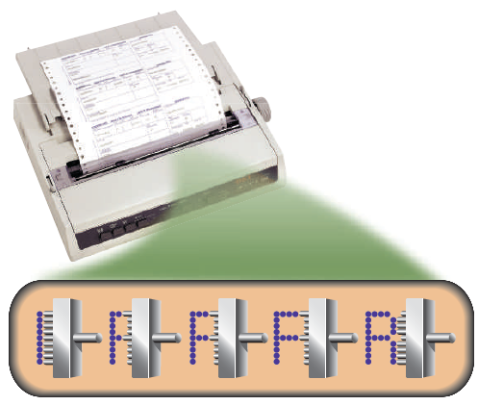
Printers (13 of 13)
Impact printers form characters and graphics on a piece of paper by striking a mechanism against an inked ribbon that physically contacts the paper
Figure 7-38 An impact printer produces printed images when tiny pins strike an inked ribbon.

Slide 53
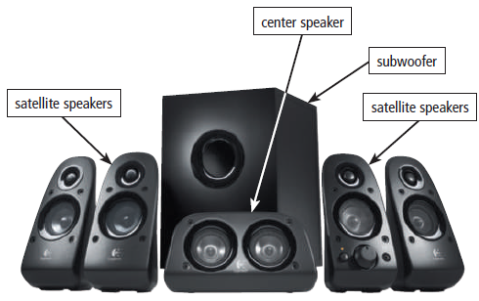
Other Output Devices (1 of 5)
Many users attach surround sound speakers or speaker systems to their computers, game consoles, and mobile devices to generate higher-quality sounds
Figure 7-39 Users often attach high-quality surround sound speaker systems to their computers, game consoles, and mobile devices.

Slide 54
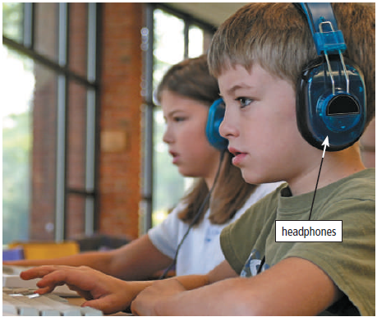
Other Output Devices (2 of 5)
Headphones are speakers that cover or are placed outside of the ear
Earbuds (also called earphones) rest inside the ear canal
Figure 7-40 In a crowded environment where speakers are not practical, users can wear headphones to hear audio output.

Slide 55
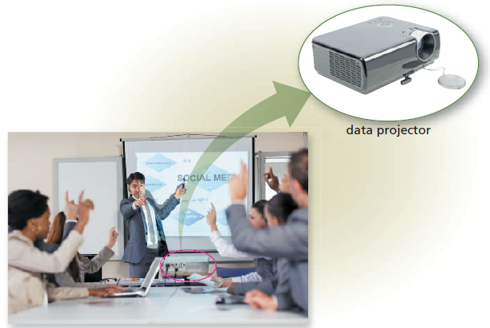
Other Output Devices (3 of 5)
A data projector is a device that projects the text and images displaying on a computer or mobile device screen on a larger screen so that an audience can see the image clearly
Figure 7-41 A data projector projects an image from a computer or mobile device screen on a larger screen so that an audience easily can see the image.

Slide 56
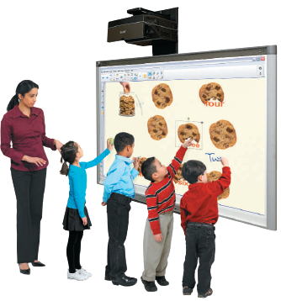
Other Output Devices (4 of 5)
An interactive whiteboard is a touch-sensitive device, resembling a dry-erase board, that displays the image on a connected computer screen
Figure 7-42 Teachers and students can write directly on an interactive whiteboard, or they can write on a slate that communicates wirelessly with the whiteboard.

Slide 57
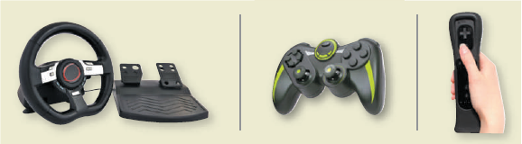
Other Output Devices (5 of 5)
Joysticks, wheels, gamepads, and motion-sensing game controllers can be considered output devices when they include force feedback
Technology that sends resistance to the device in response to actions of the user
Figure 7-43 Gaming devices often use force feedback, giving the user a realistic experience.

Slide 58
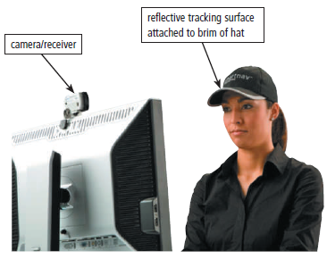
Assistive Technology Input and Output (1 of 2)
Figure 7-44 A camera/receiver mounted on the monitor tracks the position of the head-mounted pointer, which is the reflective material on the brim of the hat. As the user moves her head, the pointer on the screen also moves.

Slide 59
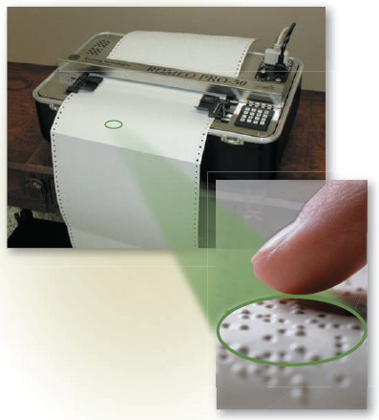
Assistive Technology Input and Output (2 of 2)
Figure 7-45 A Braille printer.

Slide 60
Summary
Variety of options for input and output
Several assistive technology options for input and output

